Slide 1
Analyzing “Hidden Patterns” in Stock Data Rutgers Data Science Bootcamp
Jan 12, 2018
Team 5
David Hui Timothy Yu Raj Ray

Slide 2
Project Scope and Goals (Motivation & Summary)
Objective and Scope
Uncover patterns in the daily price action of a key stock traded in the US market.
Stock Selected – AAPL (Traded on the NASDAQ Exchange)
Time Interval - 3 year timeframe (2015-2017)
~756 # of Datapoint – 252 trading days per year x 3
Examine potential relationships between
Daily closing price and the day of the month,
Daily stock price and its RSI indicator,
Daily stock price and volume
Data Source & Tools Used
Closing price and Relative Strength Index data
Pulled from the Alphavantage API
Python 3.0
Matplotlib, Jupyter notebook

Slide 3
Key questions/hypotheses
Are there certain months that are better for buying or selling Apple Stock?
Does the RSI give more accurate signals on a larger timeframe than on a smaller timeframe in identifying overbought and oversold conditions for Apple stock?
Is it possible to do any predictive analysis based on these patterns? (linear regression/line fit?)
Is Apple currently overbought or oversold based selected historical data (i.e. 2015-2017)?

Slide 4
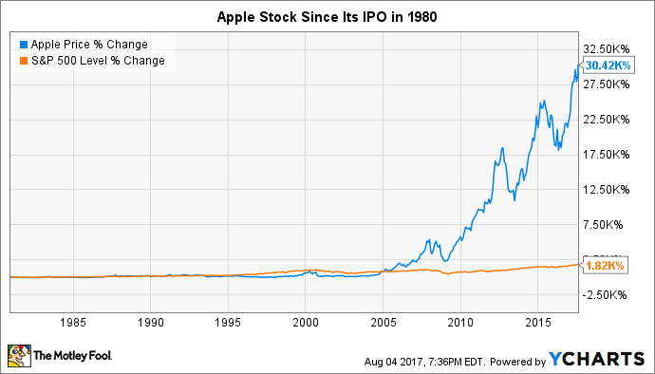
AAPL Stock Price Through the Years

Slide 5
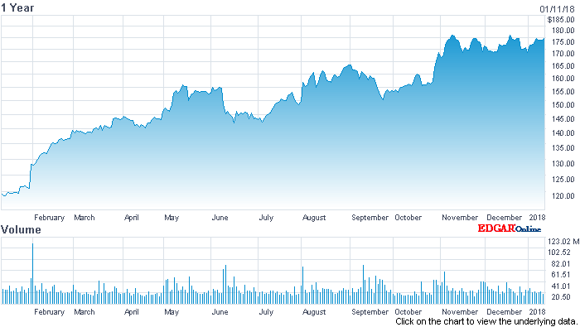

AAPL Stock Price (2017)
Apple Inc. Stock Chart

Slide 6
Data Analysis
Time series analysis was performed by performing Y-O-Y comparisons.
Closing Price
Volume
Relative Strength Index (RSI)

Slide 7
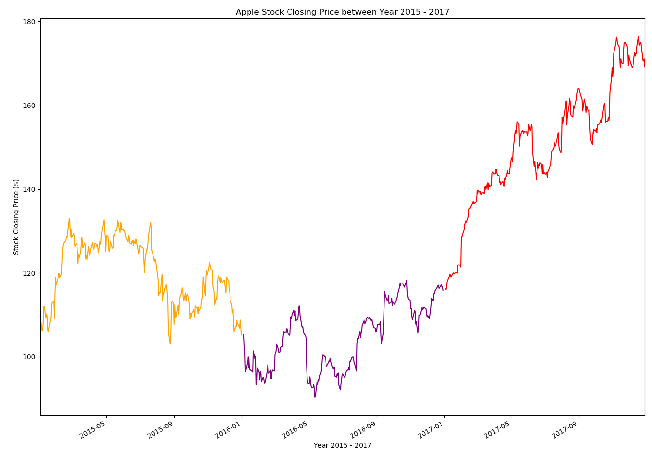
AAPL Stock Closing Price 2015-2017

Slide 8
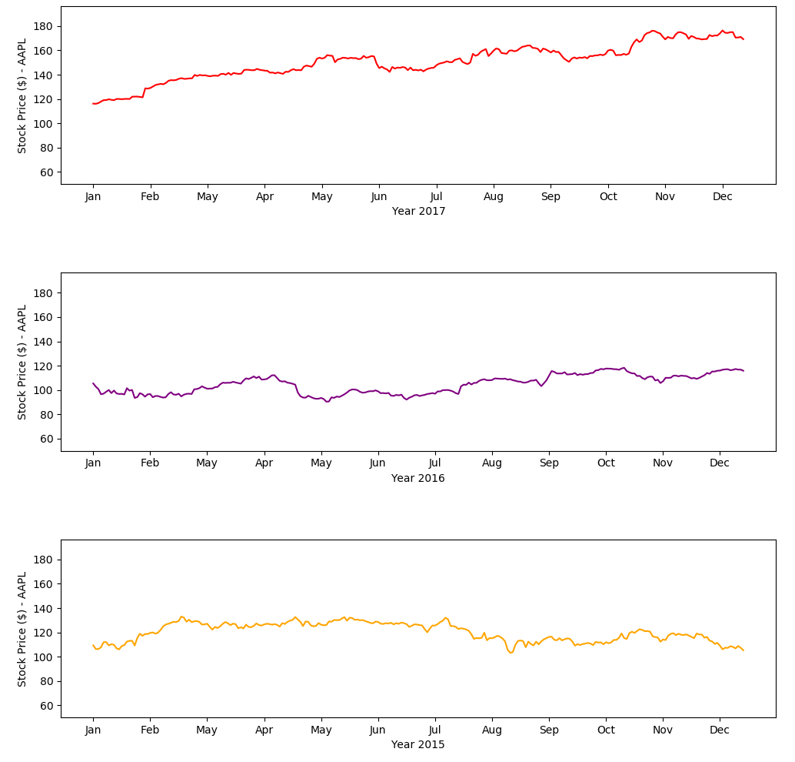
AAPL Closing Price 2015-2017

Slide 9
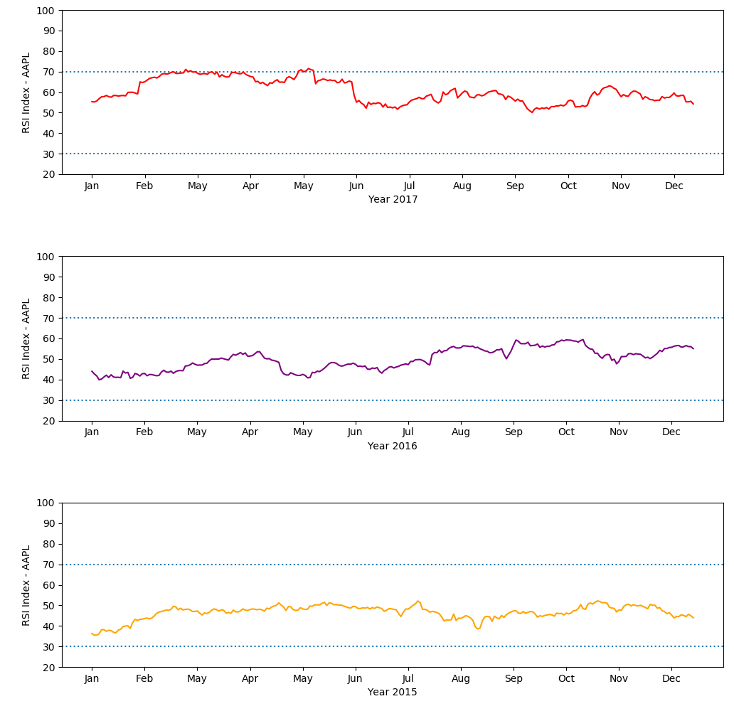
RSI (Relative Strength Index) 2015-2017

Slide 10
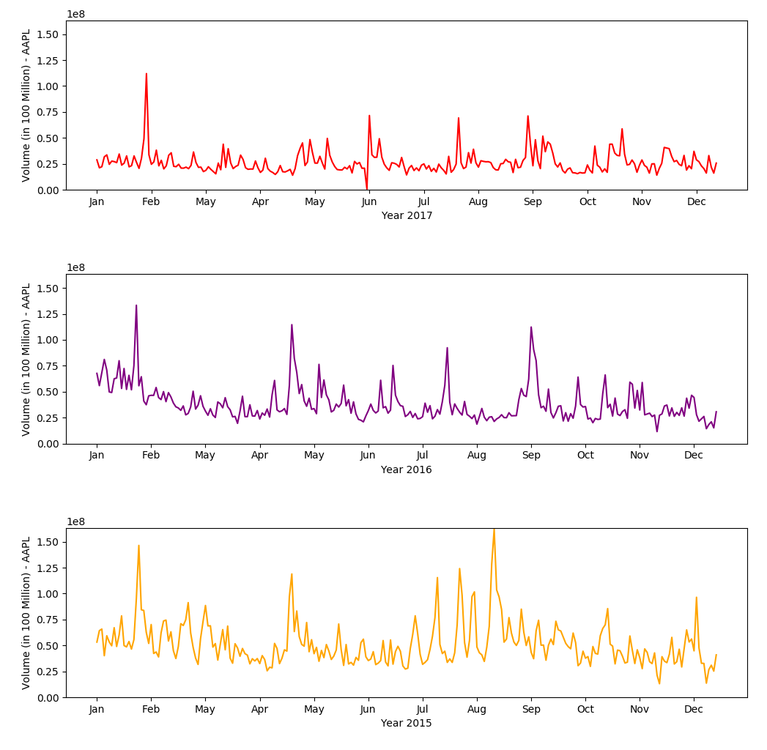
AAPL Volume 2015-2017

Slide 11
Data Exploration
Type of Data
Daily close, volume, and relative strength index from Alphavantage API
Data Exploration
Additional data were also available on daily open, daily high, daily low, inter-day data etc. but those data were not considered or eliminated from input data streams to keep the data manageable for our analysis and to prevent scope creep.

Slide 12
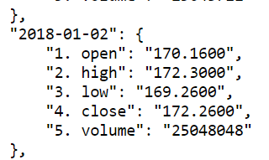
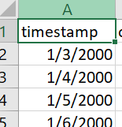

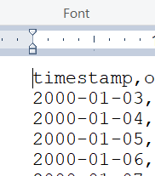
Data Cleanup
Raw JSON
CSV shows slashes
DataFrame manipulation of formatting
Open CSV in text editor to verify
Date_format was applied for parsing

Slide 13
Discussion
However, more indepth analysis is required to answer this question more sufficiently (more than 3 years of data, and price action data including the Open, High, and Low).
Are there certain months that are better for buying or selling Apple Stock?
Mid January to Mid February for is potentially better for buying, and the beginning to the Midpoint of October for potentially selling.
This is supported by looking at the closing price and RSI for those periods on a three year timeframe.
However, more in-depth analysis is required to answer this question with more validity and accuracy (more than 3 years of data, and price action data including the Open, High, and Low).

Slide 14
Constraints and Limitations
Constraints
Google and Yahoo APIs for stock market data have recently been shut down.
Other stock market APIs are not free.
Limitations
Exact month units and holidays
Single stock vs meta-study of multiple stock
One technical indicator (RSI) vs. many

Slide 15
Conclusions and Lessons Learned
If we had 2+ more weeks to research:
Can we predict the future value of Apple stock based on linear regression?
Is RSI a better technical indicator than 60-day or 90-day moving averages?
Does the Apple stock have good correlation with the overall market or is it a better performer than the market?
Backtesting/examination of the accuracy of trading indicators for APPL stock
Impact of Apple product releases and lawsuits on price

Slide 16
End
Questions?

